Slide 1

The Independent-Samples t Test
Chapter 11

Slide 2
Quick Test Reminder
One person = Z score
One sample with population standard deviation = Z test
One sample no population standard deviation = single t-test
One sample test twice = paired samples t

Slide 3
Independent Samples t-Test
Used to compare two means in a between-groups design (i.e., each participant is in only one condition)
Remember that dependent t (paired samples) is a repeated measures or within-groups design

Slide 4
Between groups design
In between groups, your sets of participant’s scores (i.e. group 1 versus group 2) have to be independent
Remember independence is the assumption that my scores are completely unrelated to your scores

Slide 5
Quick Distributions Reminder
Z = Distribution of scores
Z = distribution of means (for samples)
t = distribution of means (for samples with estimated standard deviation)
t = distribution of mean differences between paired scores (for paired samples with estimated standard deviation)
t = distribution of differences between means (for two groups independent t)

Slide 6
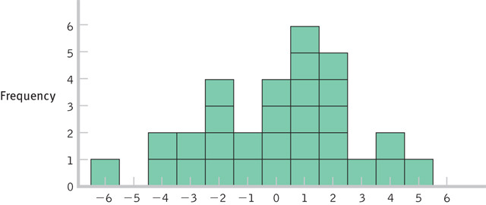
Distribution of Differences Between Means

Slide 7
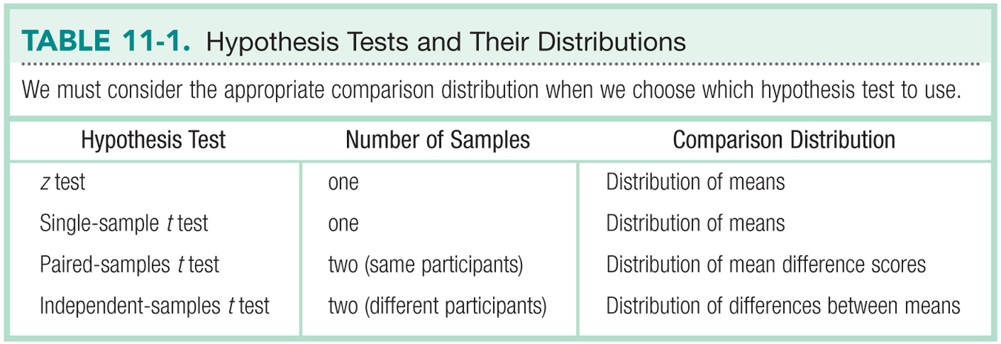
Hypothesis Tests & Distributions

Slide 8
Let’s talk about Standard Deviation
Test | Standard Deviation | Standard deviation of distribution of … (standard error)
Z | σ (population) | σ_{M}
Single t | s (sample) | s_{M}
Paired t | s (sample on difference scores) | s_{M}
Independent t | s group 1 s group 2 s_{pooled} | s_{difference}

Slide 9
Let’s talk about Standard Deviation
Variance = same for all tests, but paired t is on difference scores
Standard error = same for paired and single t
Take the square root for standard deviation of these

Slide 10
Let’s talk about Standard Deviation
Variance = same for all tests, but paired t is on difference scores
This section is for independent t only
Take the square root for standard deviation of these

Slide 11
Let’s talk about test statistics
Test type | Formula
Z | M – μ_{M} σ_{M}
Single t | M – μ_{M} s_{M}
Paired t | M s_{M}
Independent t | M – M s_{difference}

Slide 12
Additional Formulae

Slide 13
Let’s talk about df
Test type | df
Single sample | N – 1
Paired samples t | N – 1
Independent t | N – 1 + N – 1

Slide 14
Steps for Calculating Independent Sample t Tests
Step 1: Identify the populations, distribution, and assumptions.
Step 2: State the null and research hypotheses.
Step 3: Determine the characteristics of the comparison distribution.
Step 4: Determine critical values, or cutoffs.
Step 5: Calculate the test statistic.
Step 6: Make a decision.

Slide 15
Let’s work some examples!
Let’s work some examples: chapter 11 docx on blackboard.

Slide 16
Assumptions
Assumption | Solution
Normal distribution | N >=30
DV is scale | Nothing – do nonparametrics
Random selection (sampling) | Random assignment to group

Slide 17
Step 2
List the sample, population, and hypotheses
Sample: group 1 versus group 2
Population: those groups mean difference will be 0 (u – u = 0)

Slide 18
Step 2
Now, we can list those as group 1 versus group 2 in our R and N
Should also help us distinguish between independent t and dependent t
R: group 1 =/ OR > OR < group 2
N: group 1 = OR <= OR >= group 2
Watch the order!

Slide 19
Step 3
List the descriptive statistics
 | Group 1 | Group 2
Mean
SD
N
df
Spooled
Sdifference

Slide 20
Step 3
Get the mean
summary(dataset)
Get the sd
sd(dataset$column, na.rm = T)
Get N
length(dataset$column)

Slide 21
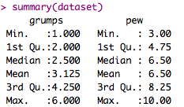



Slide 22

Step 3
Get Spooled (evil!)
spooled = sqrt( ((n1-1)*sd1^2 + (n2-1)*sd2^2) / (n1+n2 - 2))

Slide 23

Step 3
Get Sdifference (less evil)
sdifference = sqrt((spooled^2/n1 + spooled^2/n2))

Slide 24
Step 4
Since we are dealing with two groups, we have two df … but the t distribution only has one df?
So add them together!
df total = (n-1) + (n-1)

Slide 25
Step 4
Figure out the cut off score, t_{critical}
Less test:
qt(.05, df, lower.tail = T)
Greater test:
qt(.05, df, lower.tail = F)
Difference test:
qt(.05/2, df, lower.tail = T)
May also be .01 – remember to read the problem.

Slide 26
Step 5
Find t_{actual}
t.test(data$column,
data$column,
paired = F,
var.equal = T,
alternative = “less” OR “greater” OR “two.sided”,
conf.level = .95 OR .99)

Slide 27
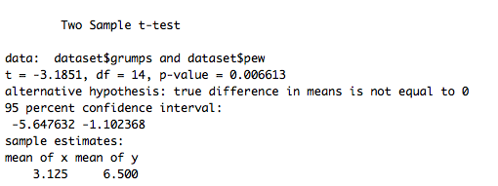
Step 5
Stop! Make sure your mean difference score, df, and hypothesis all match.

Slide 28
Step 6
Compare step 4 and 5 – is your score more extreme?
Reject the null
Compare step 4 and 5 – is your score closer to the middle?
Fail to reject the null

Slide 29
Steps for Calculating CIs
The suggestion for CI for independent t is to calculate the CI around the mean difference (M – M).
This calculation will tell you if you should reject the null – remember you do NOT want it to include 0.
Does not match what people normally do in research papers (which is calculate each M CI separately).

Slide 30
Confidence Interval
Lower = M_{difference} – t_{critical}*SE
Upper = M_{difference} + t_{critical}*SE
A quicker way!
Use t.test() with a TWO tailed test to get the two tailed confidence interval.
The r script effsize will give you each mean CI separately (how to interpret?).

Slide 31
Effect Size
Used to supplement hypothesis testing
Cohen’s d:

Slide 32

Effect Size
Remember, t(df) = t, p = p-value, d = d
SE = standard error for each group, NOT Sdifference.
Each CI here is calculated with df
of the individual groups, not the total.

